Slide 1
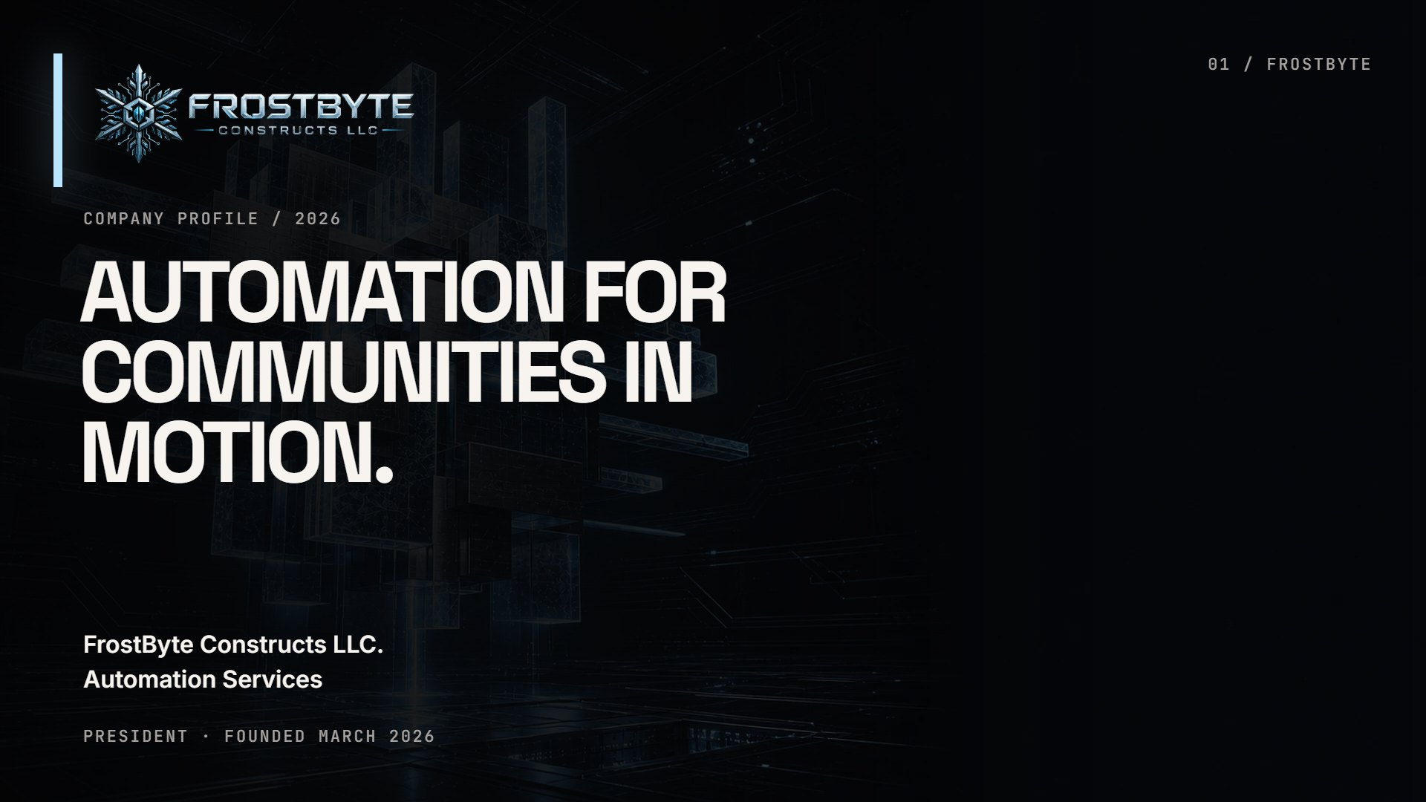
Notes:
Cover
Company profile / 2026 AUTOMATION FORCOMMUNITIES INMOTION. FrostByte Constructs LLC.Automation Services President · Founded March 2026 01 / FROSTBYTE

Slide 2
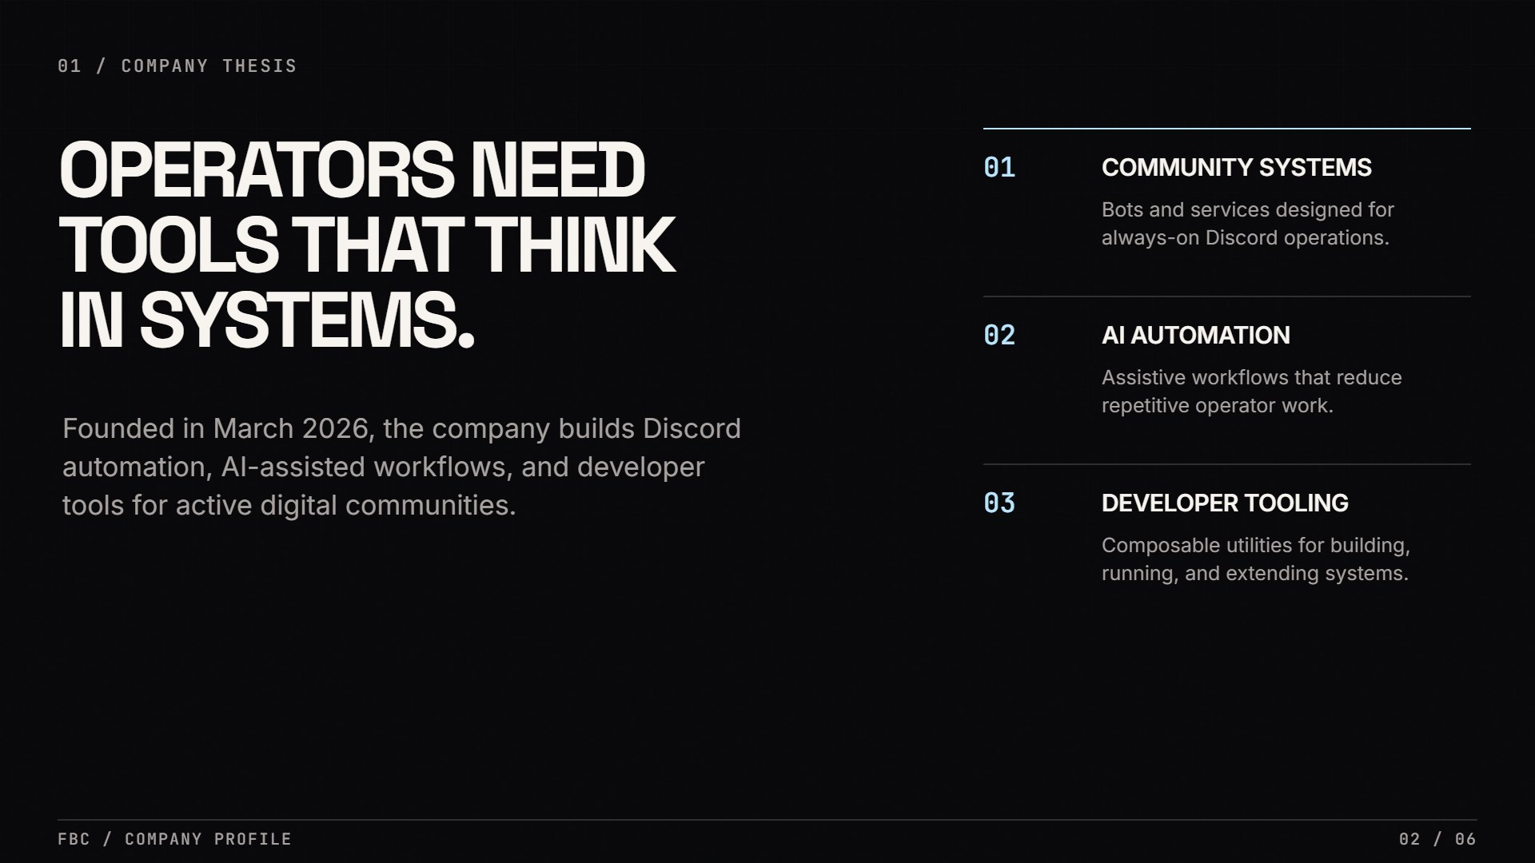
Notes:
Company thesis
01 / Company thesis OPERATORS NEEDTOOLS THAT THINKIN SYSTEMS. Founded in March 2026, the company builds Discord automation, AI-assisted workflows, and developer tools for active digital communities. 01 COMMUNITY SYSTEMS Bots and services designed for always-on Discord operations. 02 AI AUTOMATION Assistive workflows that reduce repetitive operator work. 03 DEVELOPER TOOLING Composable utilities for building, running, and extending systems. FBC / Company profile02 / 06

Slide 3
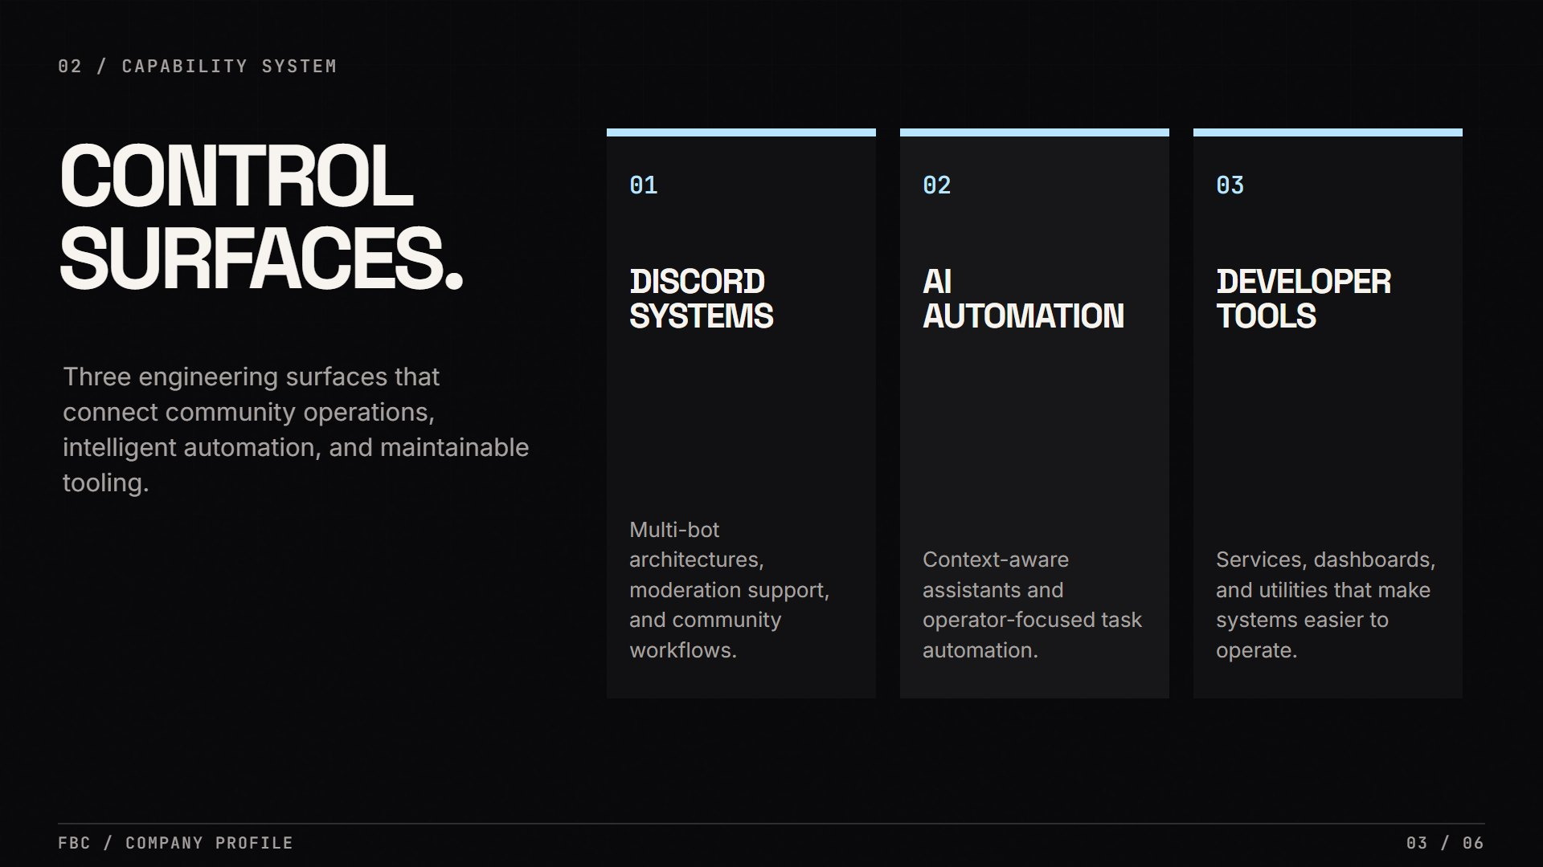
Notes:
Capabilities
02 / Capability system CONTROLSURFACES. Three engineering surfaces that connect community operations, intelligent automation, and maintainable tooling. 01 DISCORDSYSTEMS Multi-bot architectures, moderation support, and community workflows. 02 AIAUTOMATION Context-aware assistants and operator-focused task automation. 03 DEVELOPERTOOLS Services, dashboards, and utilities that make systems easier to operate. FBC / Company profile03 / 06

Slide 4
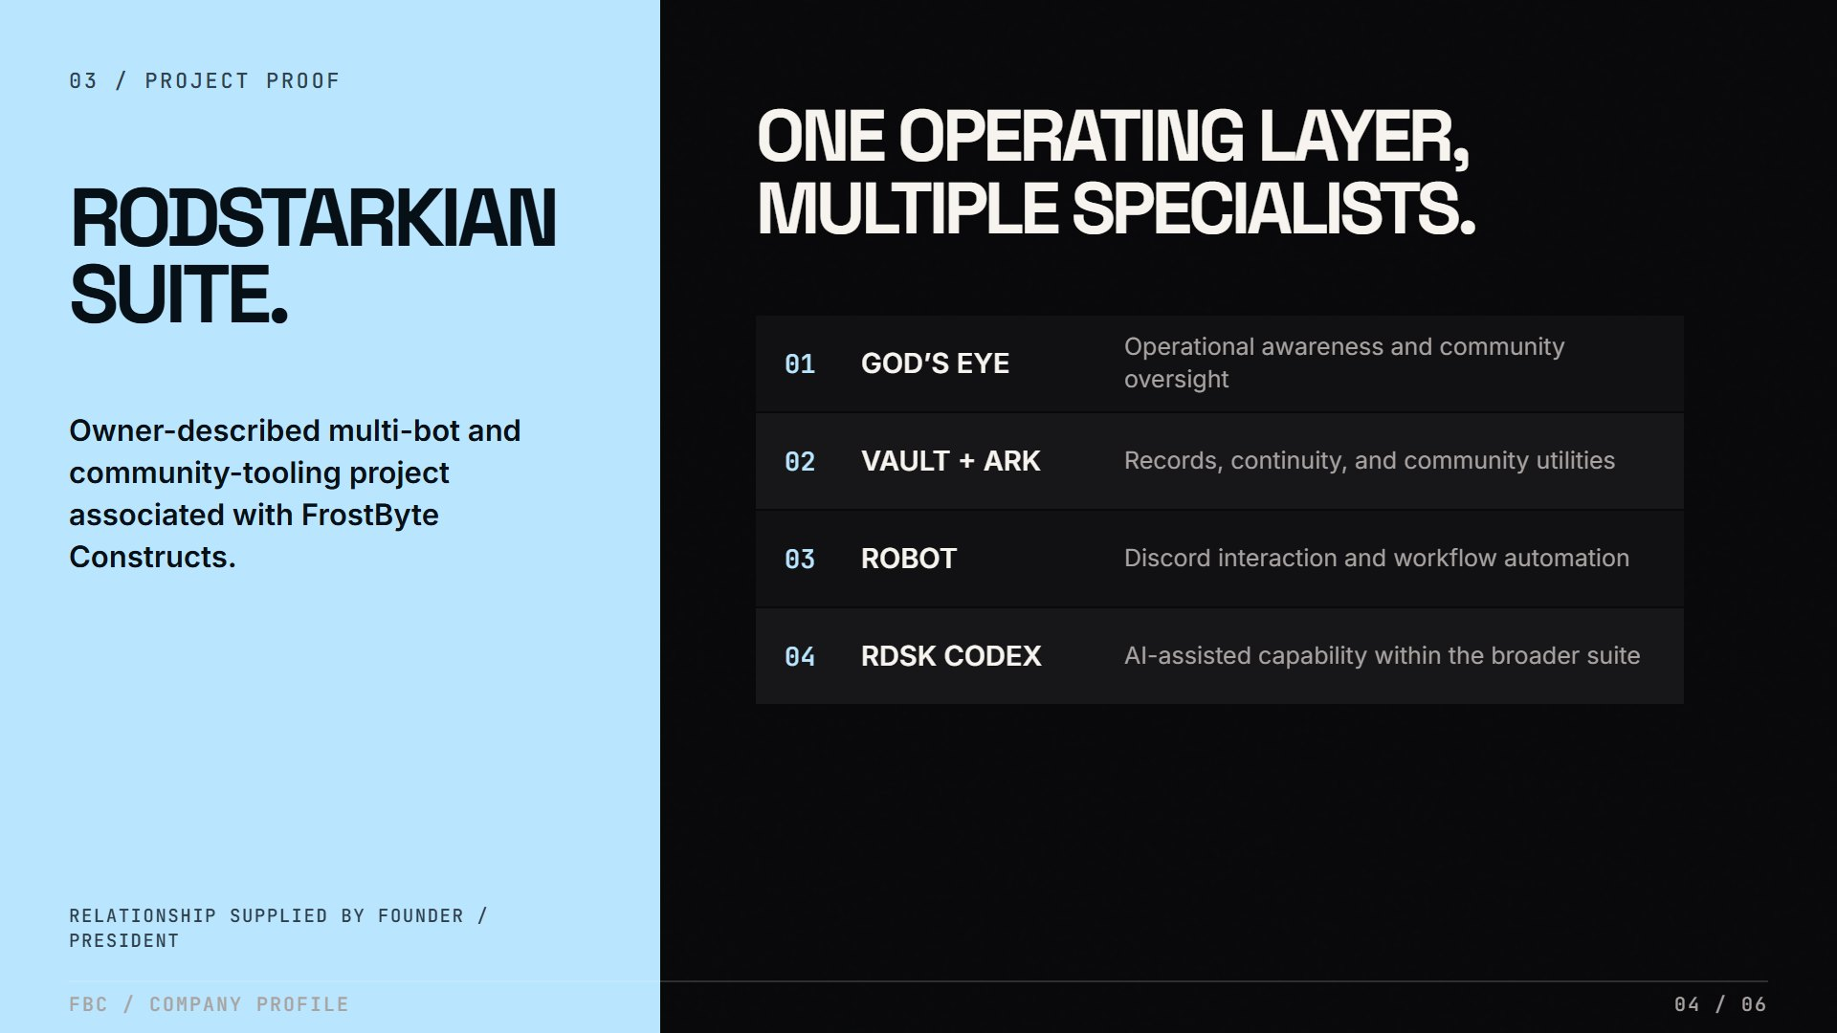
Notes:
Project proof
03 / Project proof RODSTARKIANSUITE. Owner-described multi-bot and community-tooling project associated with FrostByte Constructs. Relationship supplied by founder / president ONE OPERATING LAYER,MULTIPLE SPECIALISTS. 01 GOD’S EYE Operational awareness and community oversight 02 VAULT + ARK Records, continuity, and community utilities 03 ROBOT Discord interaction and workflow automation 04 RDSK CODEX AI-assisted capability within the broader suite FBC / Company profile04 / 06

Slide 5
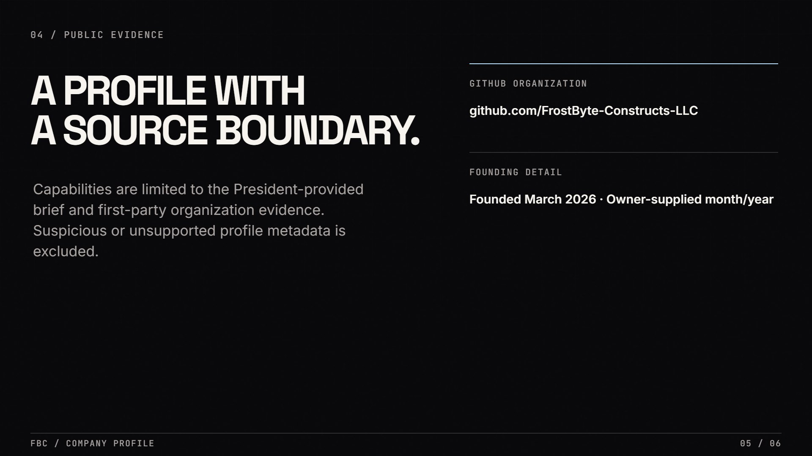
Notes:
Public evidence
04 / Public evidence A PROFILE WITHA SOURCE BOUNDARY. Capabilities are limited to the President-provided brief and first-party organization evidence. Suspicious or unsupported profile metadata is excluded. GITHUB ORGANIZATION github.com/FrostByte-Constructs-LLC FOUNDING DETAIL Founded March 2026 · Owner-supplied month/year FBC / Company profile05 / 06

Slide 6
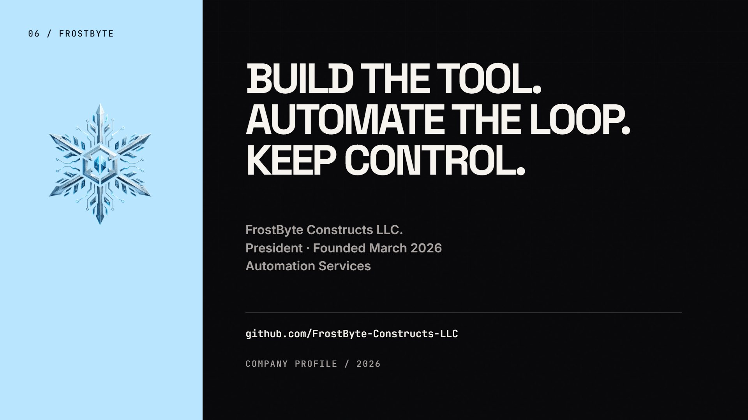
Notes:
Closing
06 / FROSTBYTE BUILD THE TOOL.AUTOMATE THE LOOP.KEEP CONTROL. FrostByte Constructs LLC.President · Founded March 2026Automation Services github.com/FrostByte-Constructs-LLC Company profile / 2026

