Slide 1

Notes:
Cover
Company profile / 2026 BUILD THE NEXT WORKING SYSTEM. NexGen LAVA, Inc.IT consulting and services Founder / CEO · Founded October 2023 01 / NEXGEN LAVA

Slide 2
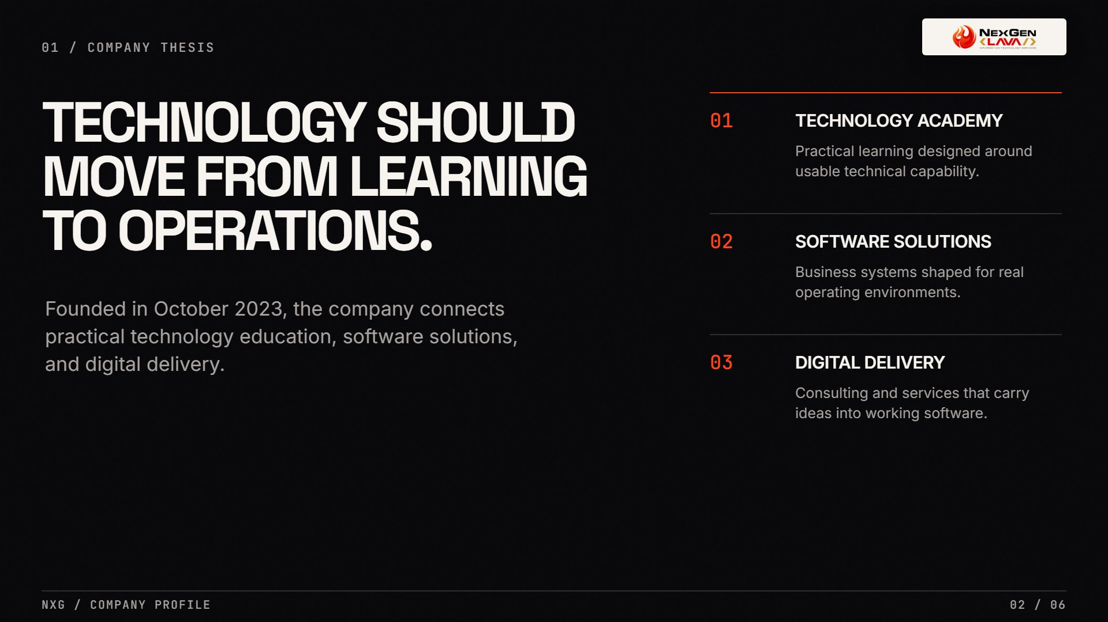
Notes:
Company thesis
01 / Company thesis TECHNOLOGY SHOULD MOVE FROM LEARNING TO OPERATIONS. Founded in October 2023, the company connects practical technology education, software solutions, and digital delivery. 01 TECHNOLOGY ACADEMY Practical learning designed around usable technical capability. 02 SOFTWARE SOLUTIONS Business systems shaped for real operating environments. 03 DIGITAL DELIVERY Consulting and services that carry ideas into working software. NXG / Company profile02 / 06

Slide 3
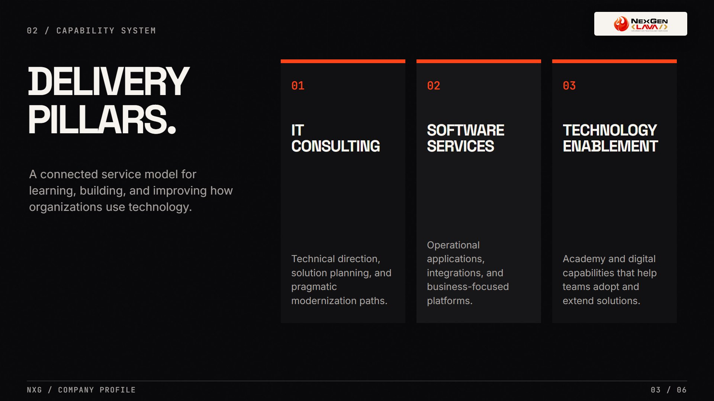
Notes:
Capabilities
02 / Capability system DELIVERY PILLARS. A connected service model for learning, building, and improving how organizations use technology. 01 IT CONSULTING Technical direction, solution planning, and pragmatic modernization paths. 02 SOFTWARE SERVICES Operational applications, integrations, and business-focused platforms. 03 TECHNOLOGY ENABLEMENT Academy and digital capabilities that help teams adopt and extend solutions. NXG / Company profile03 / 06

Slide 4
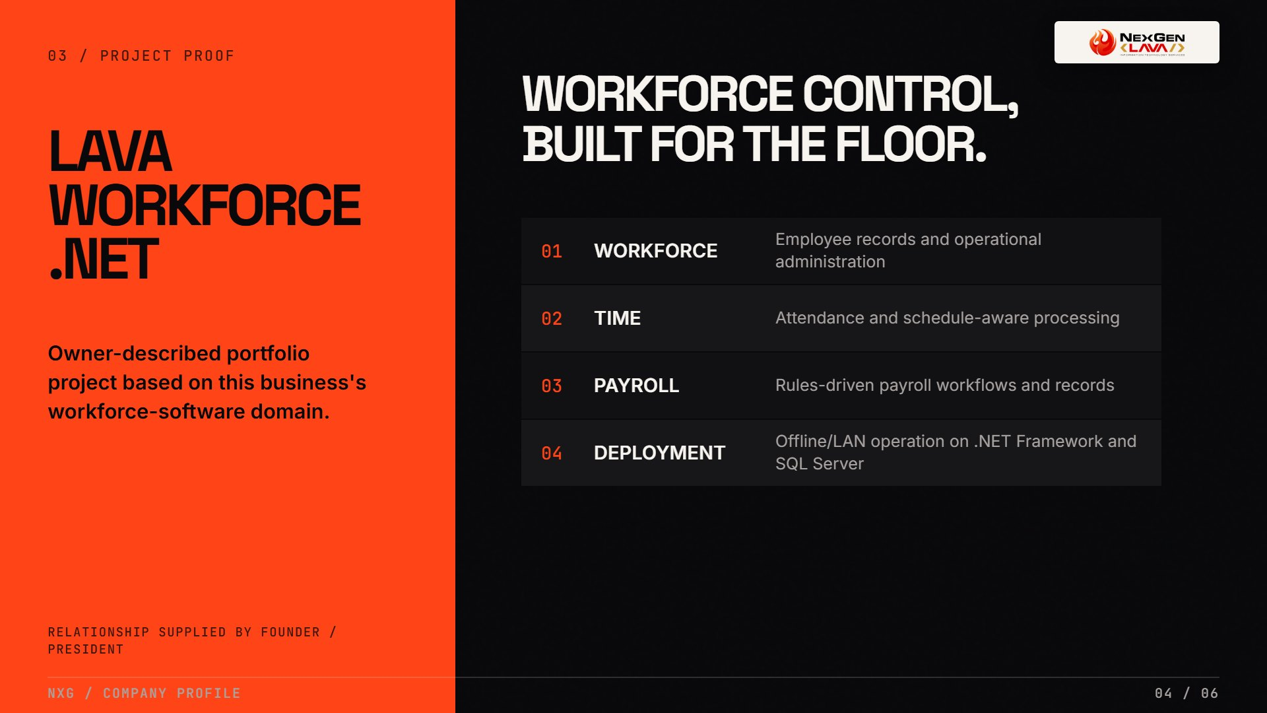
Notes:
Project proof
03 / Project proof LAVA WORKFORCE .NET Owner-described portfolio project based on this business's workforce-software domain. Relationship supplied by founder / president WORKFORCE CONTROL, BUILT FOR THE FLOOR. 01 WORKFORCE Employee records and operational administration 02 TIME Attendance and schedule-aware processing 03 PAYROLL Rules-driven payroll workflows and records 04 DEPLOYMENT Offline/LAN operation on .NET Framework and SQL Server NXG / Company profile04 / 06

Slide 5
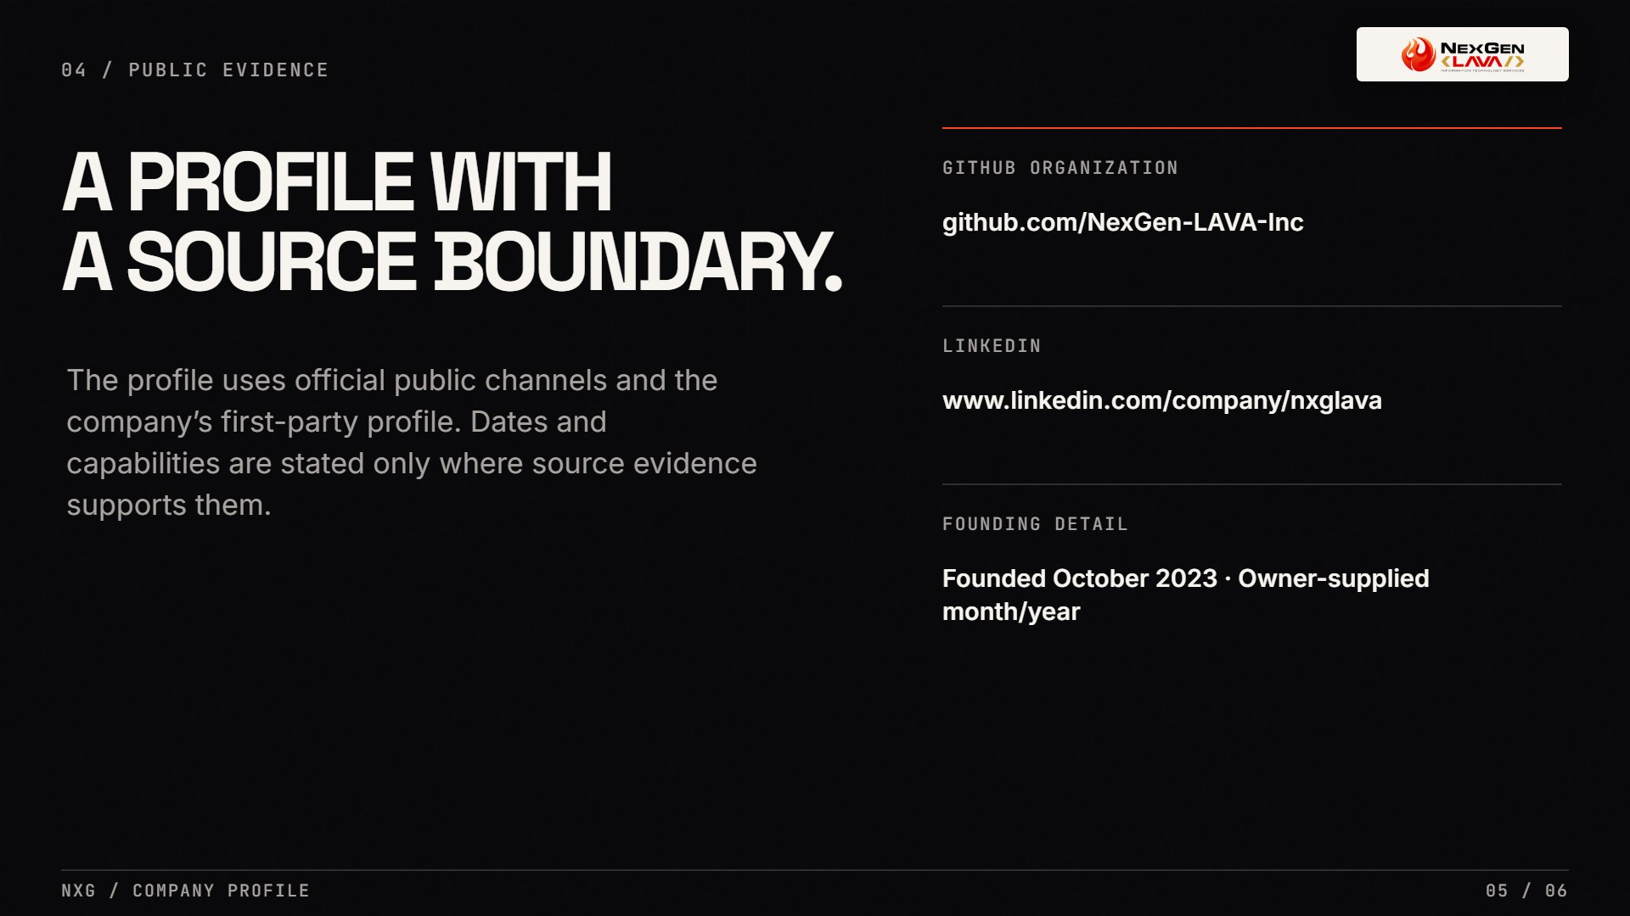
Notes:
Public evidence
04 / Public evidence A PROFILE WITHA SOURCE BOUNDARY. The profile uses official public channels and the company’s first-party profile. Dates and capabilities are stated only where source evidence supports them. GITHUB ORGANIZATION github.com/NexGen-LAVA-Inc LINKEDIN www.linkedin.com/company/nxglava FOUNDING DETAIL Founded October 2023 · Owner-supplied month/year NXG / Company profile05 / 06

Slide 6
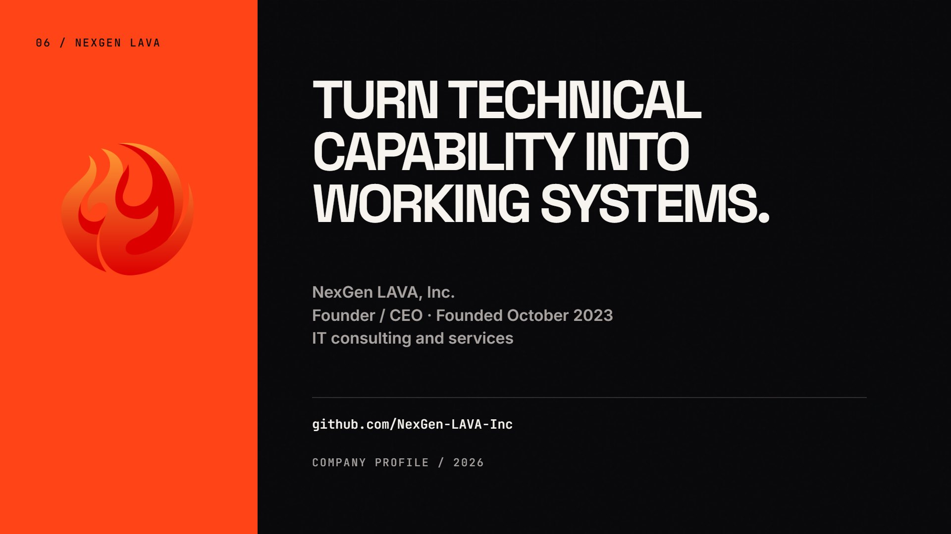
Notes:
Closing
06 / NEXGEN LAVA TURN TECHNICAL CAPABILITY INTO WORKING SYSTEMS. NexGen LAVA, Inc.Founder / CEO · Founded October 2023IT consulting and services github.com/NexGen-LAVA-Inc Company profile / 2026

