Slide 1
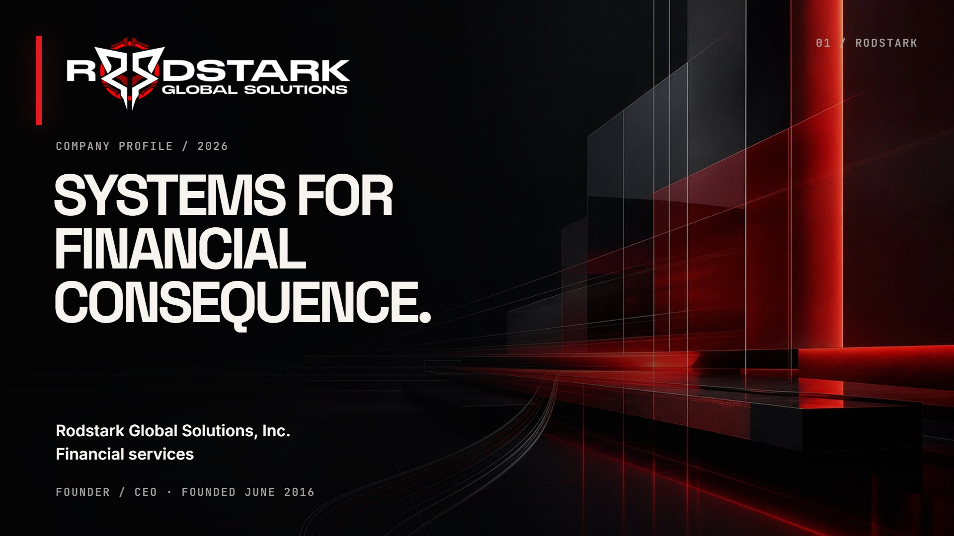
Notes:
Cover
Company profile / 2026 SYSTEMS FORFINANCIALCONSEQUENCE. Rodstark Global Solutions, Inc.Financial services Founder / CEO · Founded June 2016 01 / RODSTARK

Slide 2
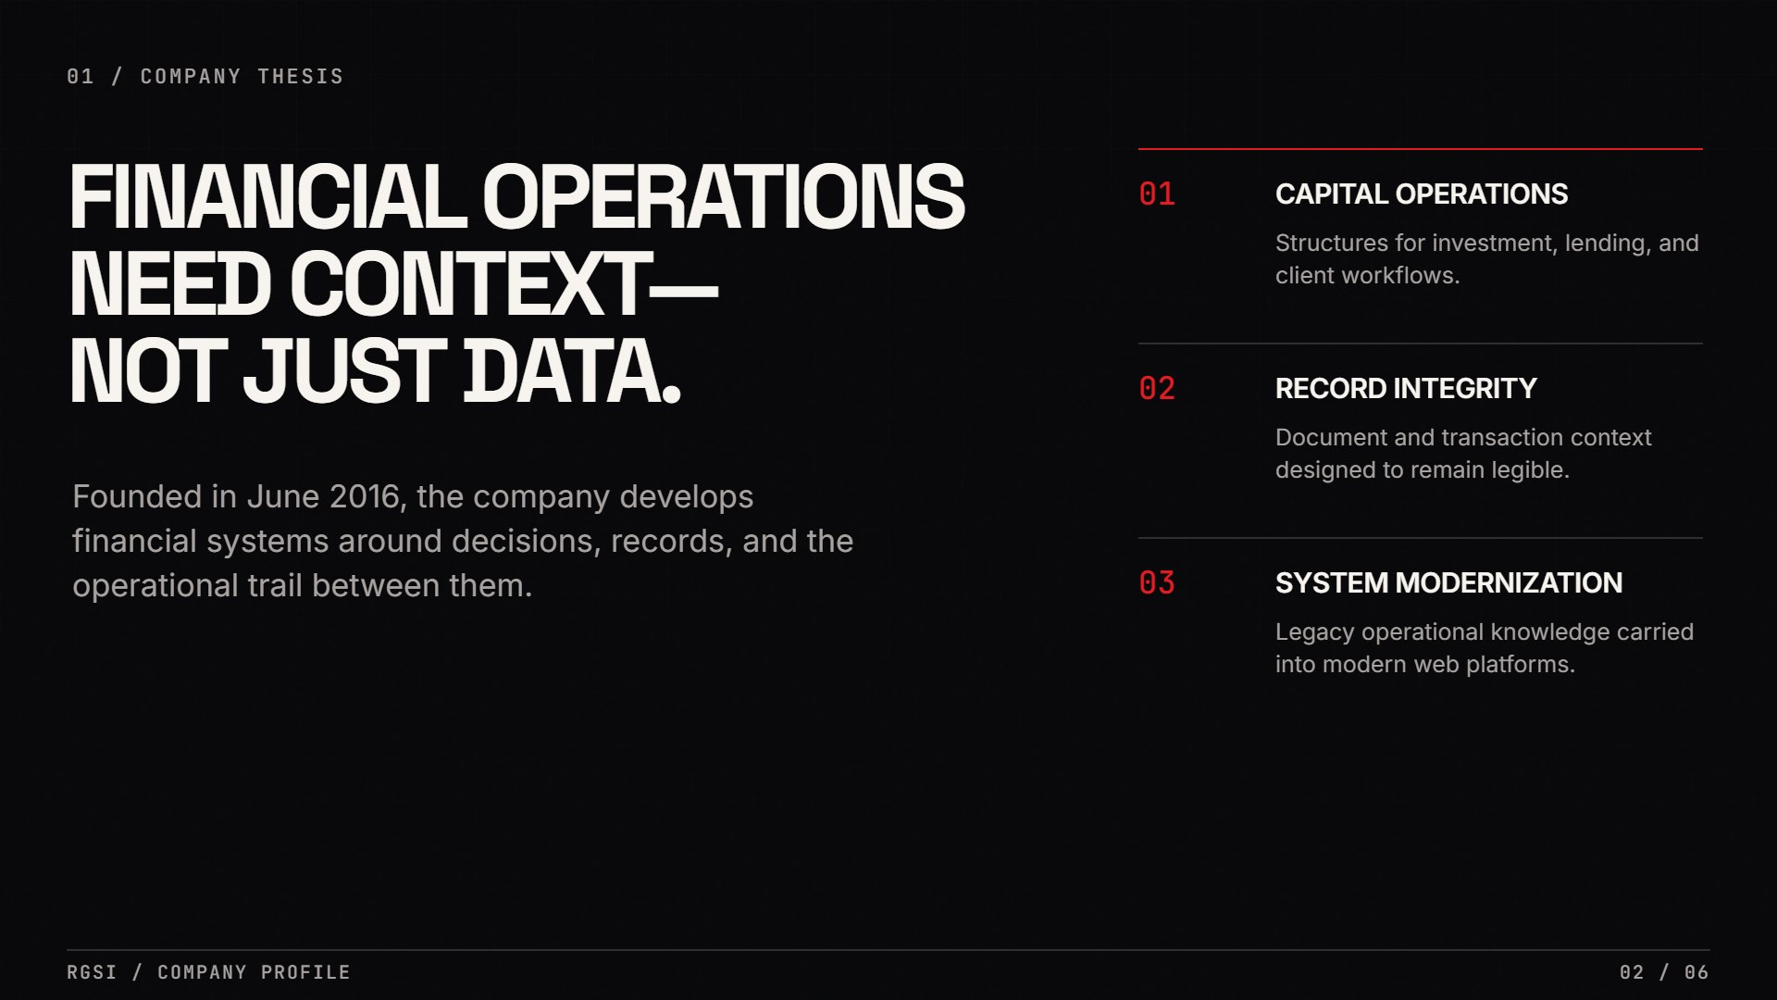
Notes:
Company thesis
01 / Company thesis FINANCIAL OPERATIONSNEED CONTEXT—NOT JUST DATA. Founded in June 2016, the company develops financial systems around decisions, records, and the operational trail between them. 01 CAPITAL OPERATIONS Structures for investment, lending, and client workflows. 02 RECORD INTEGRITY Document and transaction context designed to remain legible. 03 SYSTEM MODERNIZATION Legacy operational knowledge carried into modern web platforms. RGSI / Company profile02 / 06

Slide 3
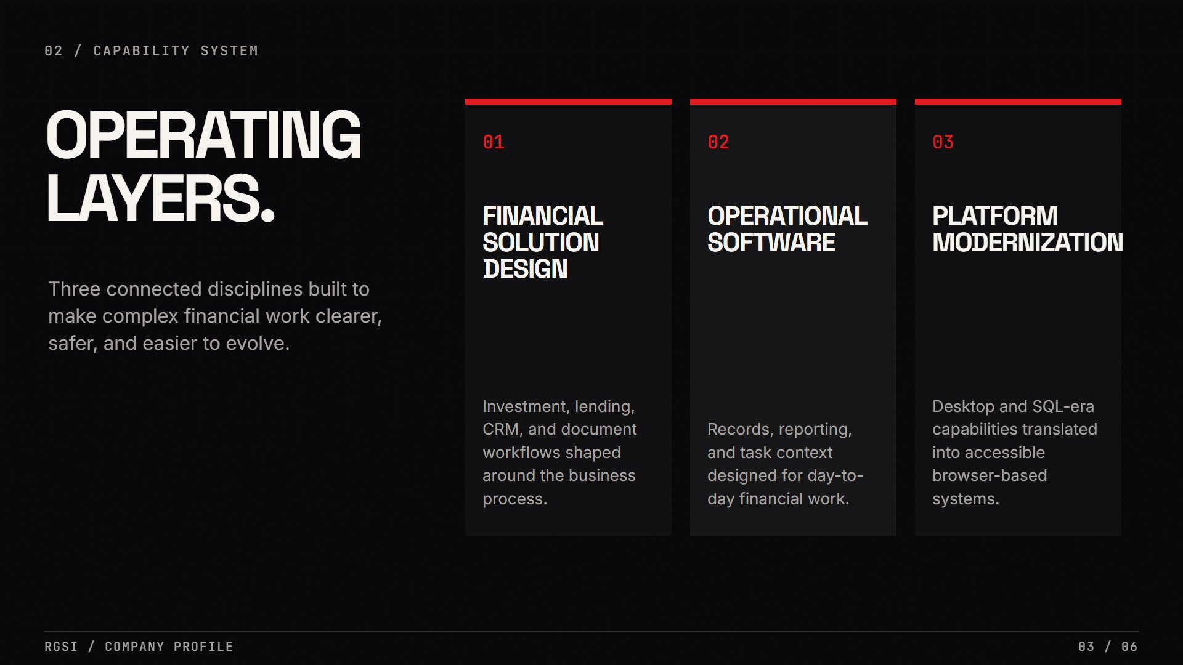
Notes:
Capabilities
02 / Capability system OPERATINGLAYERS. Three connected disciplines built to make complex financial work clearer, safer, and easier to evolve. 01 FINANCIALSOLUTION DESIGN Investment, lending, CRM, and document workflows shaped around the business process. 02 OPERATIONALSOFTWARE Records, reporting, and task context designed for day-to-day financial work. 03 PLATFORMMODERNIZATION Desktop and SQL-era capabilities translated into accessible browser-based systems. RGSI / Company profile03 / 06

Slide 4
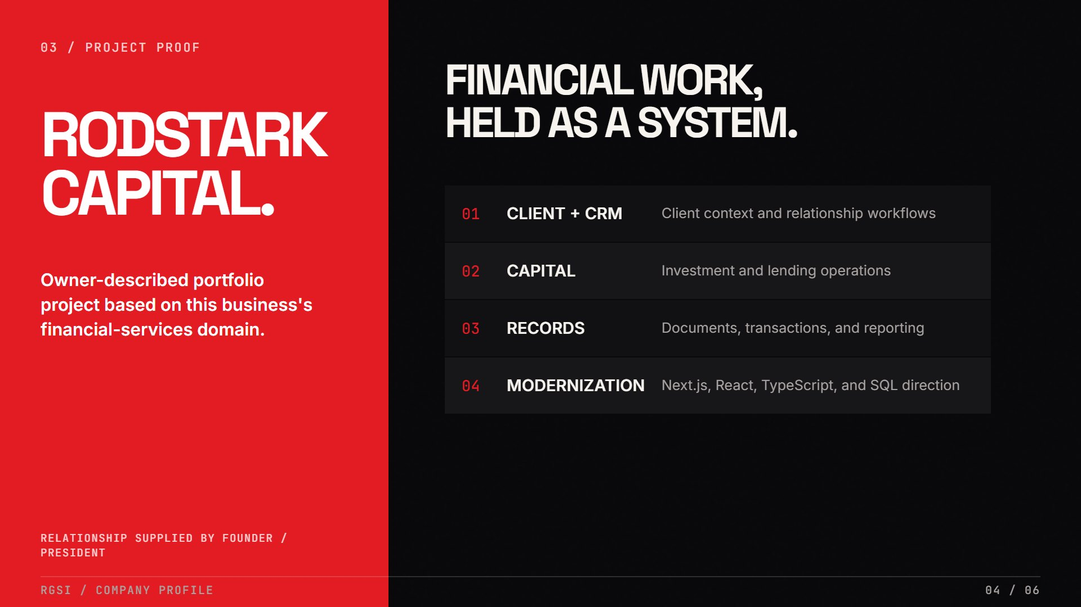
Notes:
Project proof
03 / Project proof RODSTARKCAPITAL. Owner-described portfolio project based on this business's financial-services domain. Relationship supplied by founder / president FINANCIAL WORK,HELD AS A SYSTEM. 01 CLIENT + CRM Client context and relationship workflows 02 CAPITAL Investment and lending operations 03 RECORDS Documents, transactions, and reporting 04 MODERNIZATION Next.js, React, TypeScript, and SQL direction RGSI / Company profile04 / 06

Slide 5
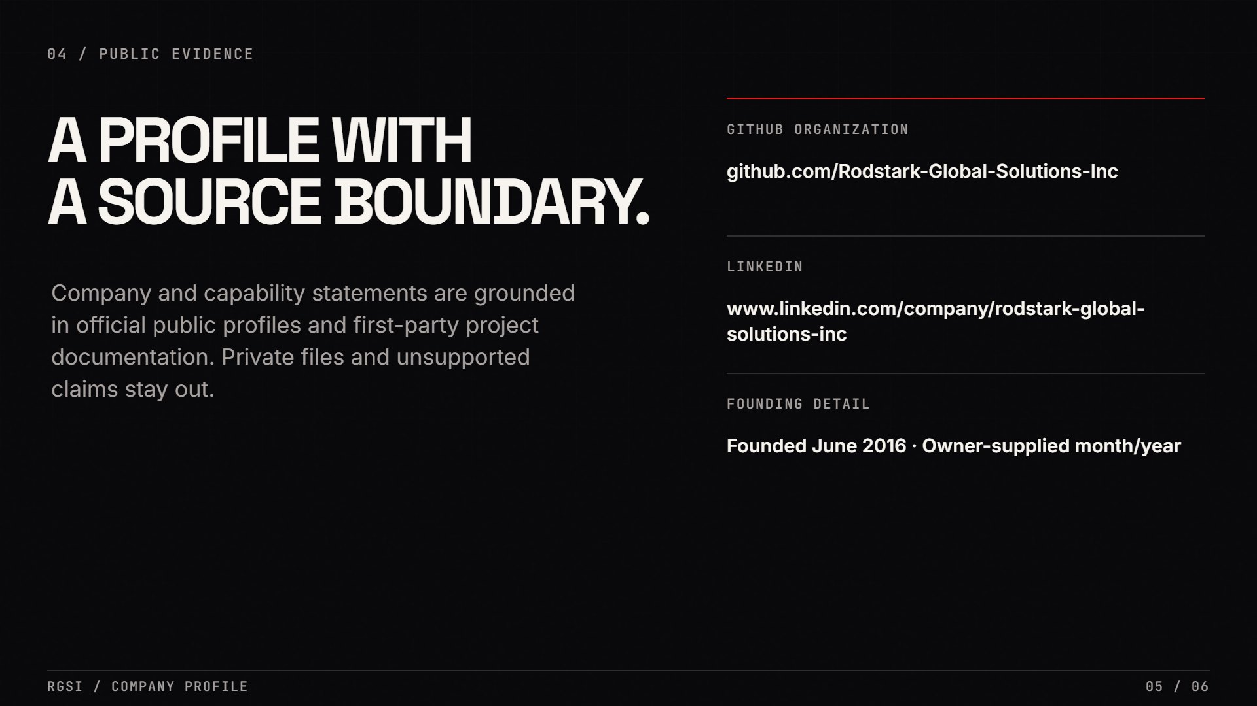
Notes:
Public evidence
04 / Public evidence A PROFILE WITHA SOURCE BOUNDARY. Company and capability statements are grounded in official public profiles and first-party project documentation. Private files and unsupported claims stay out. GITHUB ORGANIZATION github.com/Rodstark-Global-Solutions-Inc LINKEDIN www.linkedin.com/company/rodstark-global-solutions-inc FOUNDING DETAIL Founded June 2016 · Owner-supplied month/year RGSI / Company profile05 / 06

Slide 6
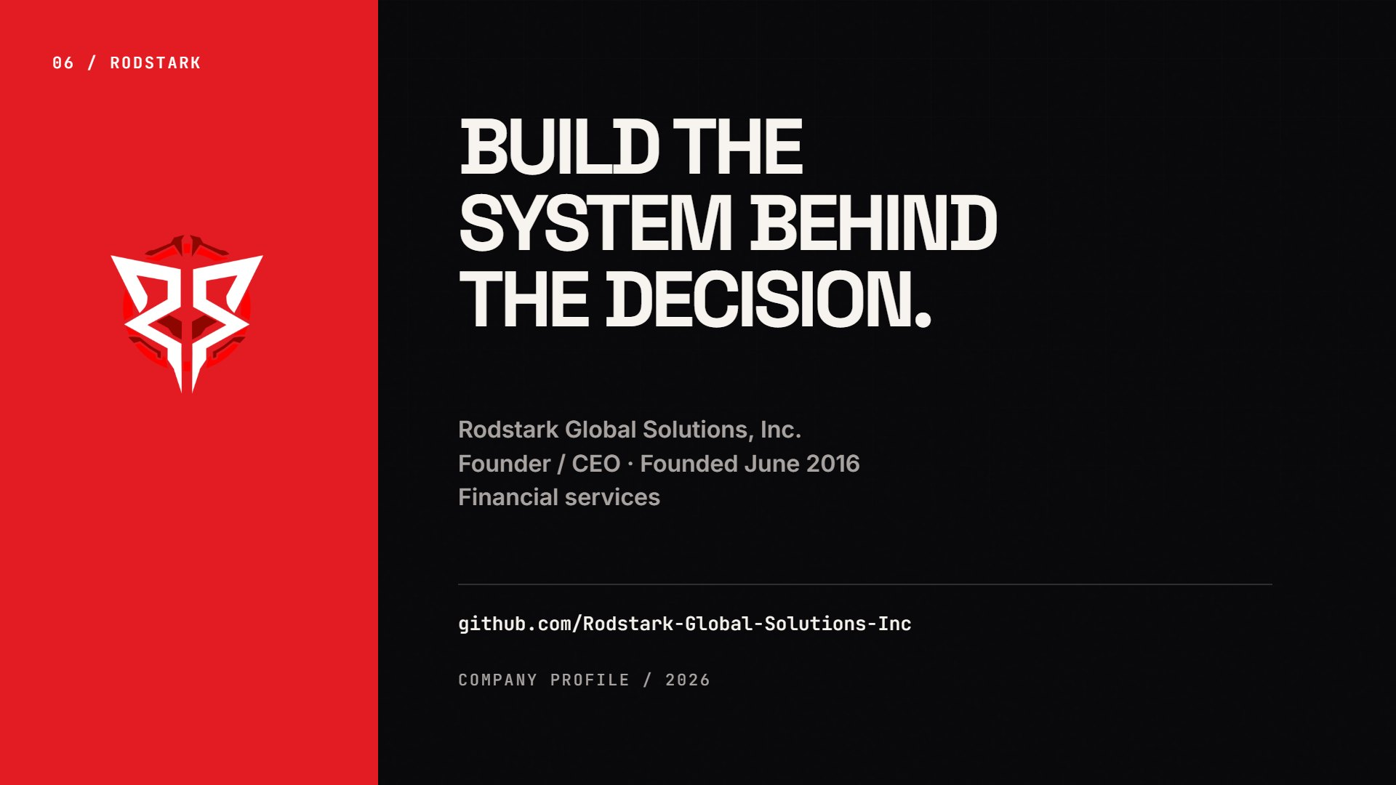
Notes:
Closing
06 / RODSTARK BUILD THESYSTEM BEHINDTHE DECISION. Rodstark Global Solutions, Inc.Founder / CEO · Founded June 2016Financial services github.com/Rodstark-Global-Solutions-Inc Company profile / 2026

